Slide 1
Reinforcement Learning Venkata Lakshmi Dasari

Slide 2
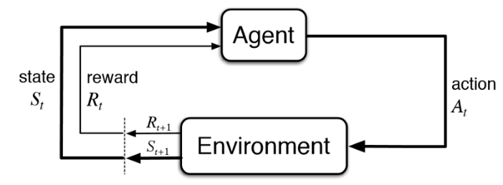
What is reinforcement Learning

Slide 3
Deep Deterministic Policy Gradient (DDPG)
policy network
i) This network will take the state of the game
for example: the velocity of the car, the distance between the car and the track axis etc..
It is called Policy-Based Reinforcement Learning because we will directly parametrize the policy.
π​θ​​(s,a)=P[a∣s,θ]
s is the state
a is the action
and θ is the model parameters of the policy network.

Slide 4

Issues
TD error
A critic is used for evaluating the policy function estimated by the actor according to the temporal difference (TD) error.

Slide 5
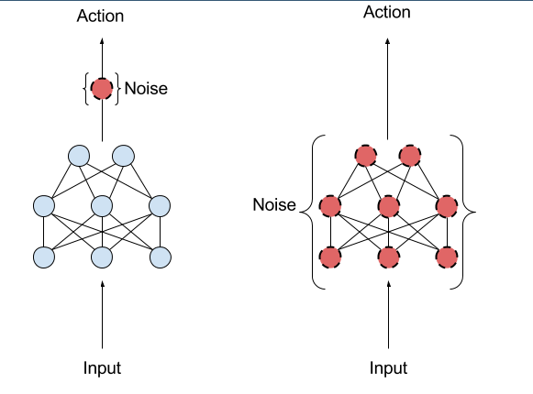
Noise Issue
We use DDPG to play TORCS game.

